Slide 1

SKILLCRAFT TECHNOLOGY INTERNSHIP
MACHINE LEARNING TASKS
BY: GOGIKAR YESHIKA NANDA

Slide 2
TASK 1
Implement a linear regression model to predict the prices of houses based on their square footage and the number of bedrooms and bathrooms.

Slide 3
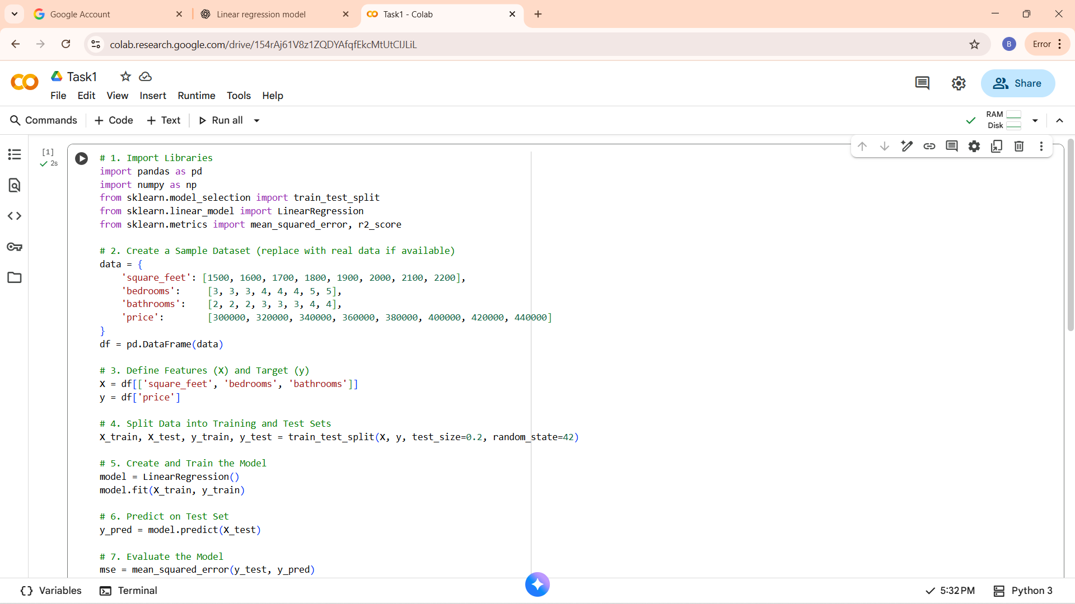
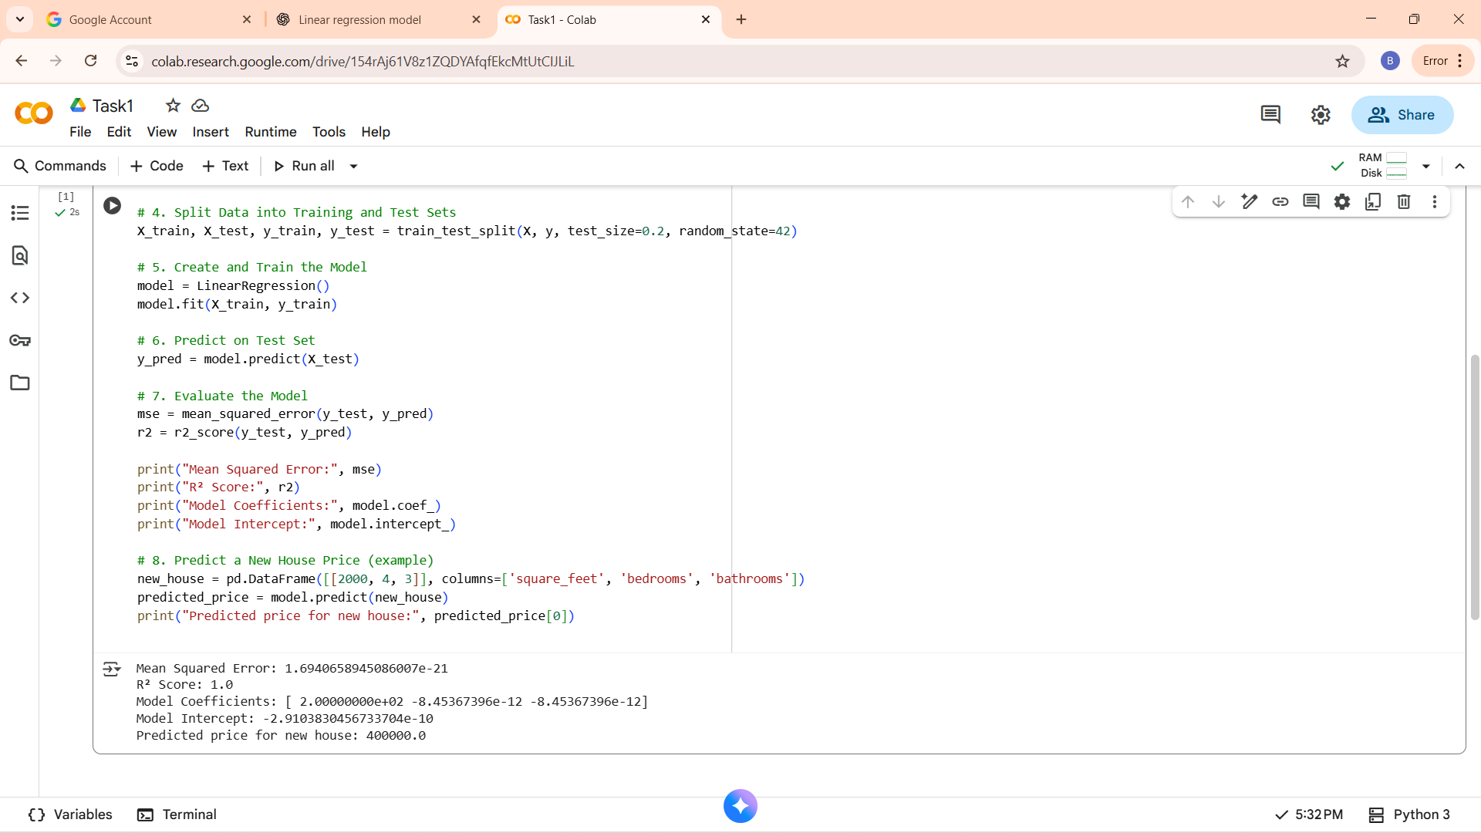
OUTPUT

Slide 4
TASK 2
Create a k-means clustering algorithm to group customers of a retail store based on their purchase history.

Slide 5
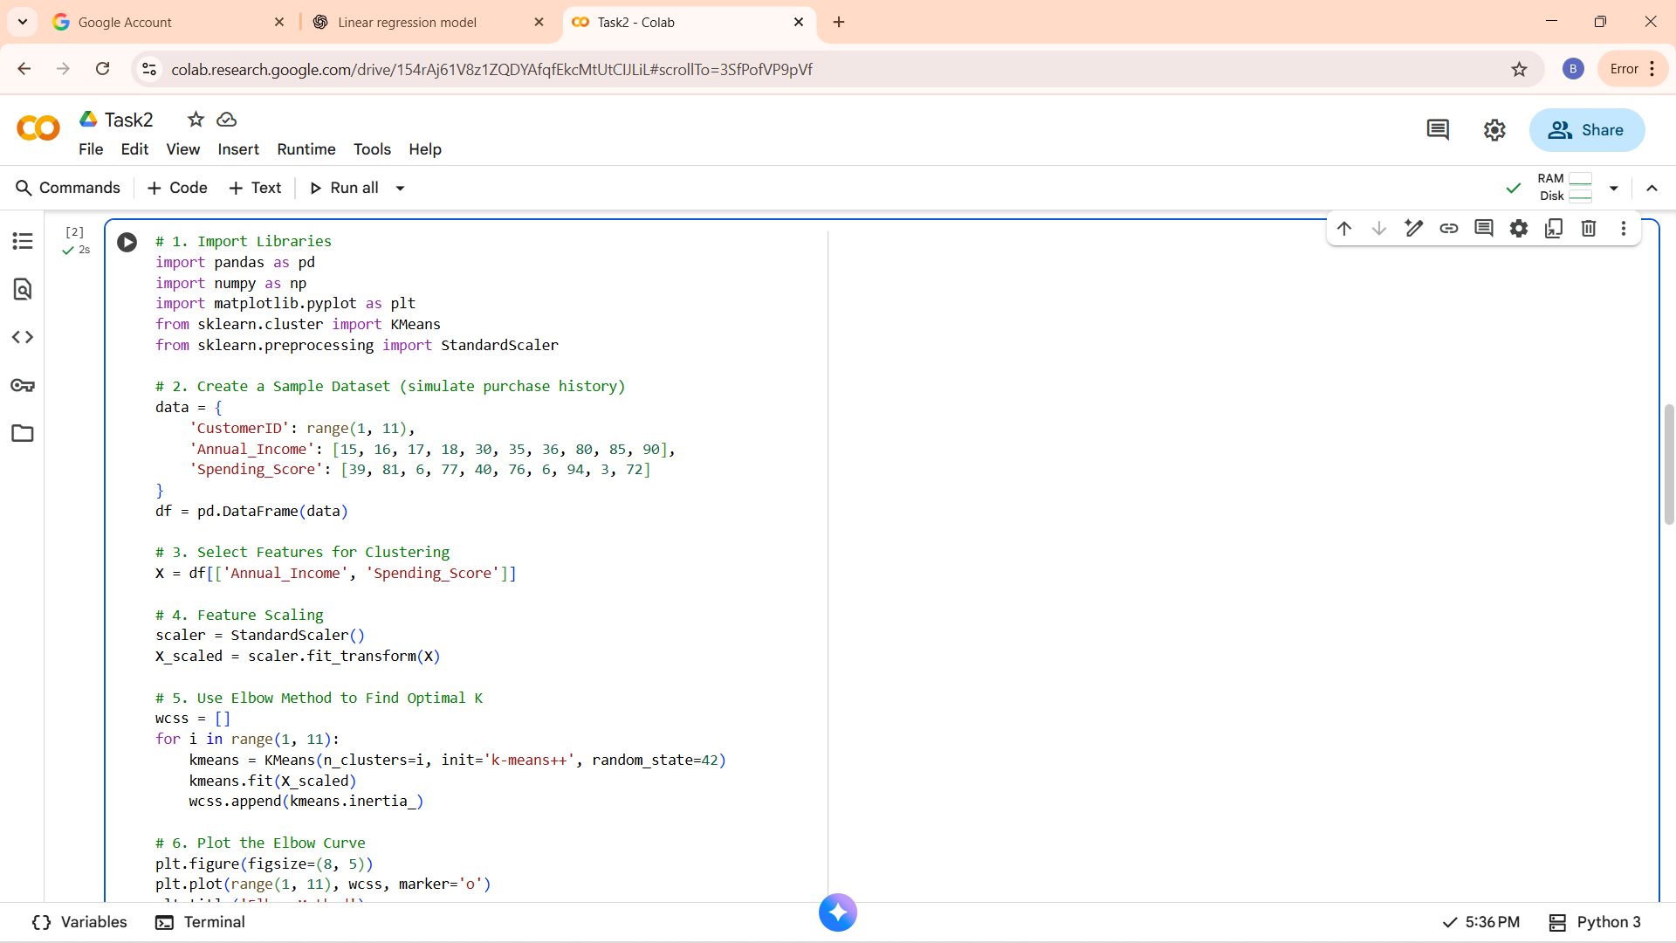
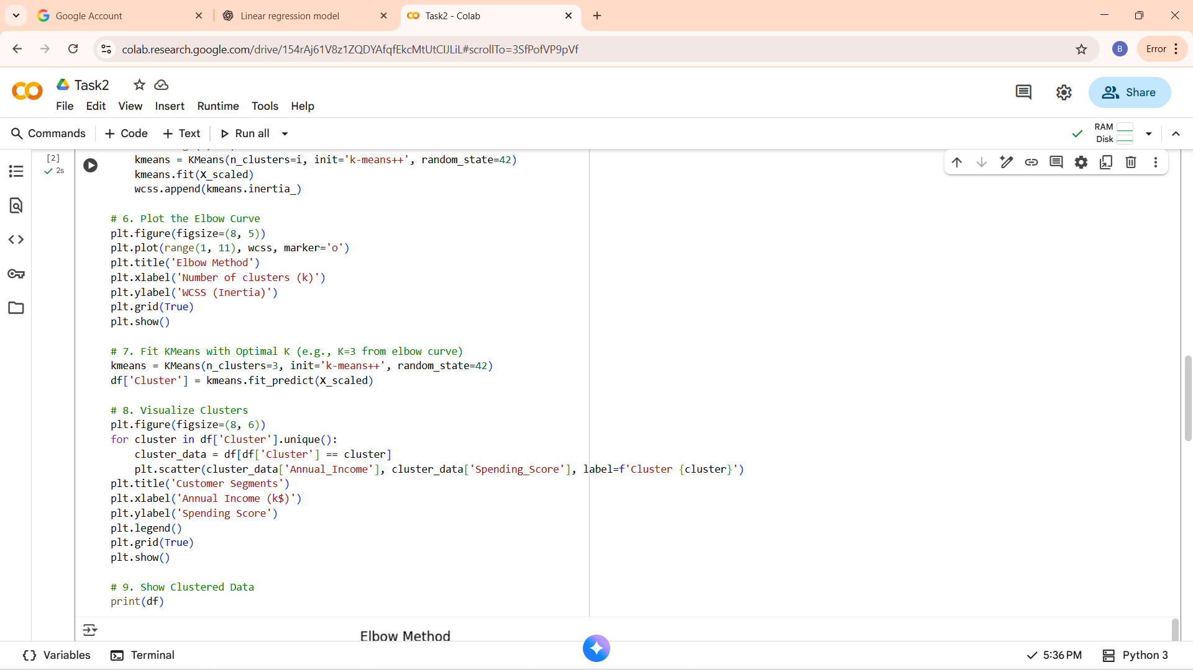
OUTPUT

Slide 6
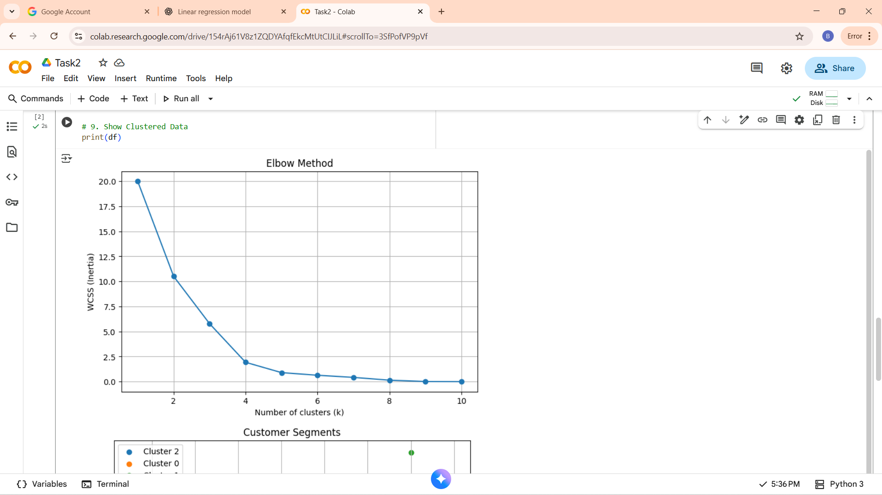
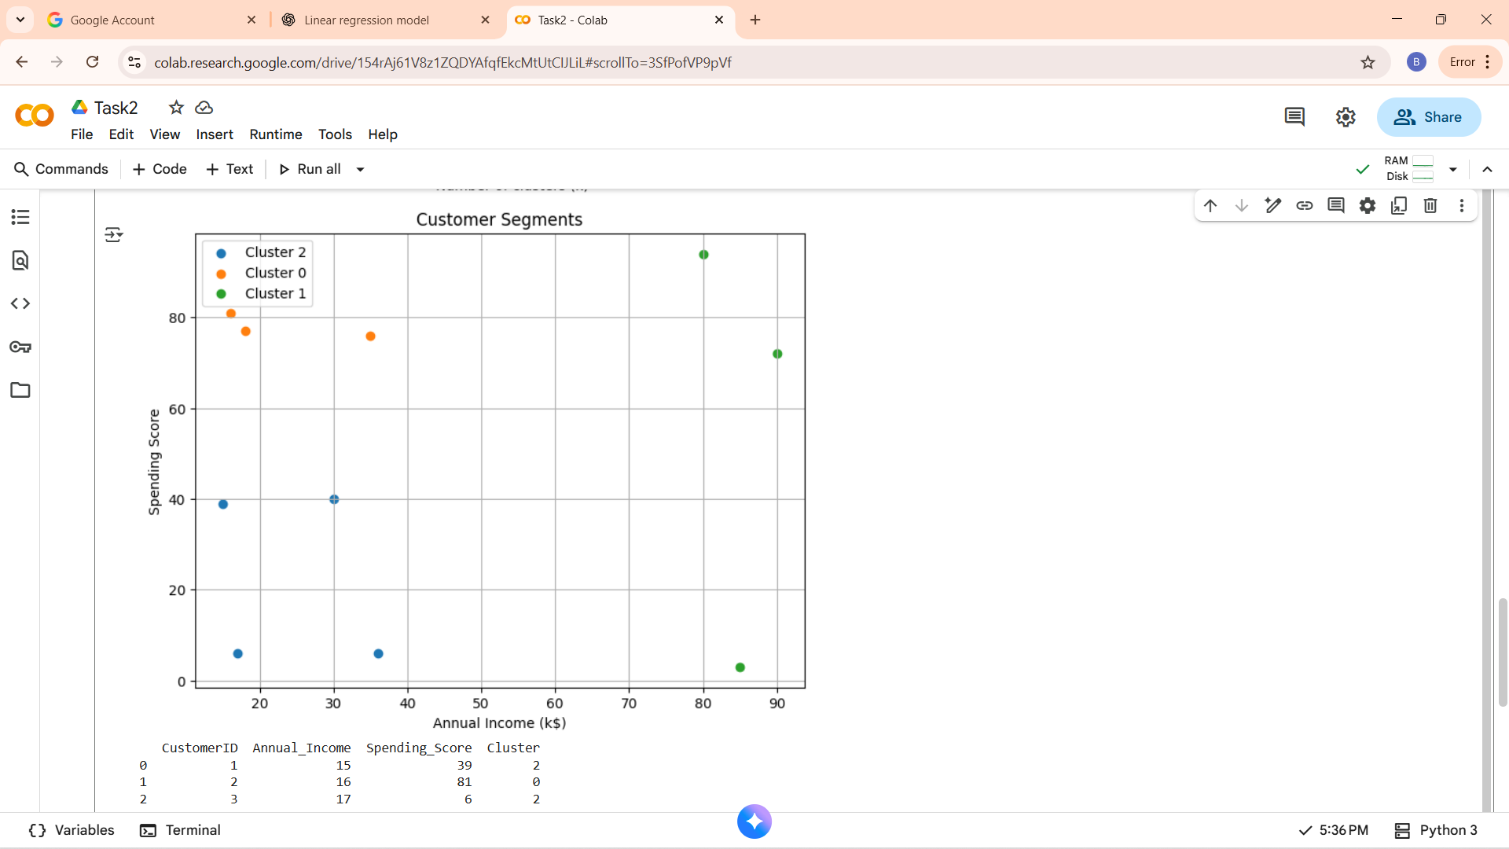

Slide 7
TASK 3
Implement a support vector machine to classify images of cats and dogs from the kaggle dataset.
Dataset is taken manually.

Slide 8
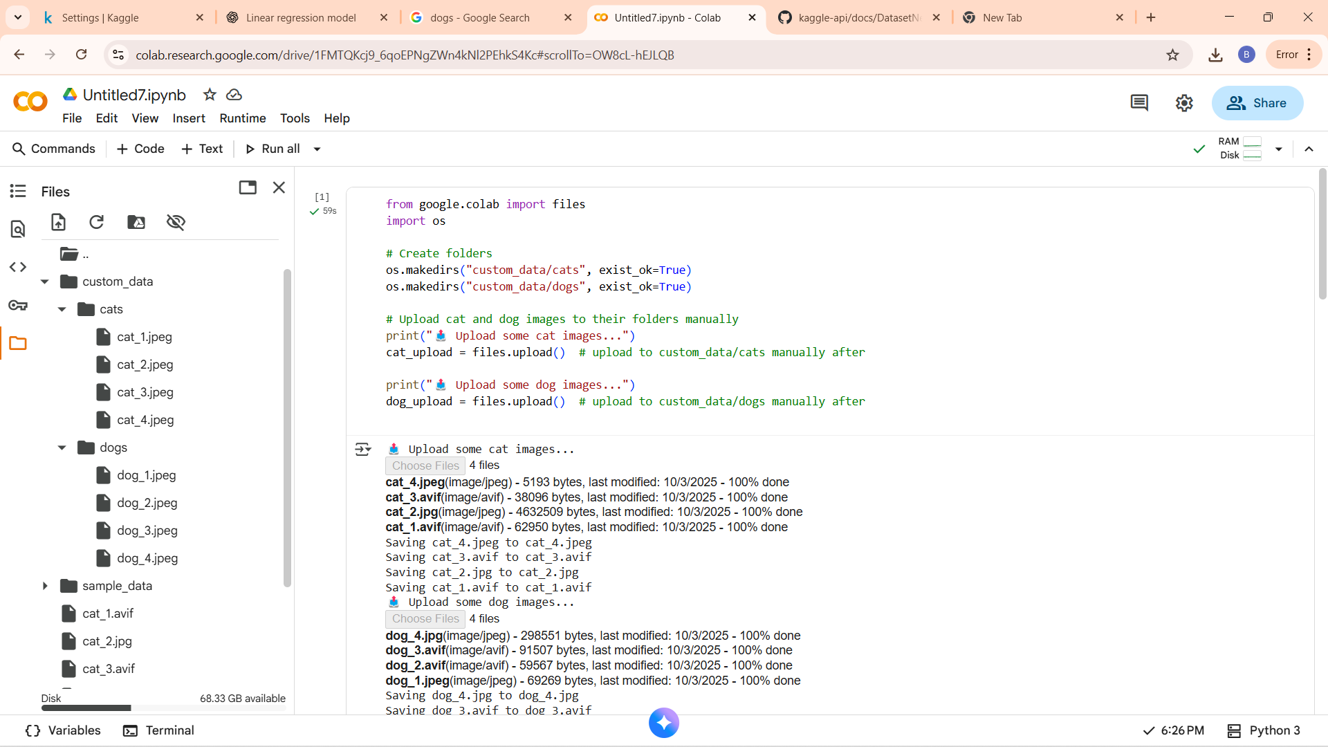
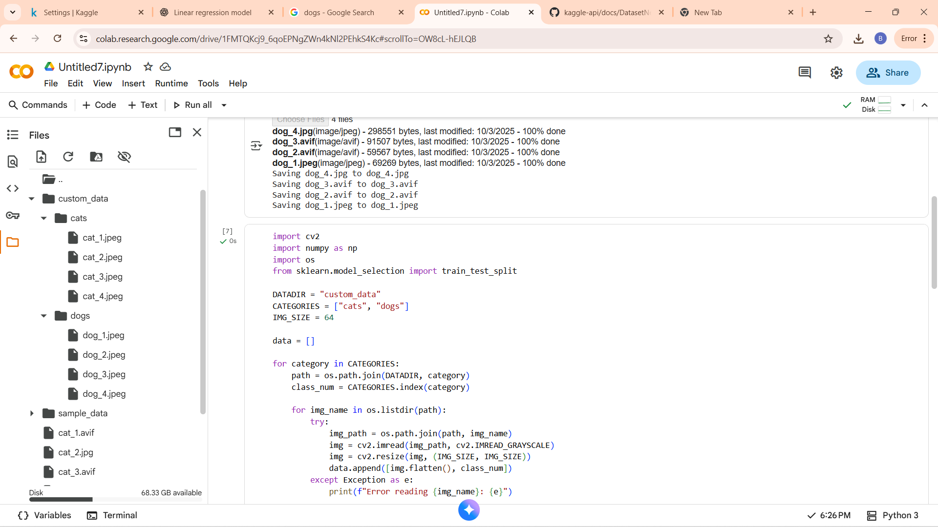
OUTPUT

Slide 9
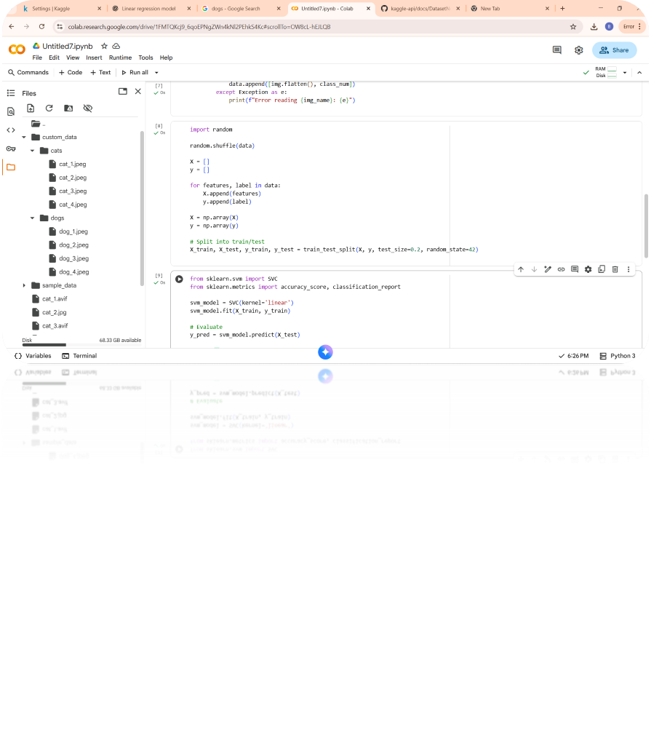
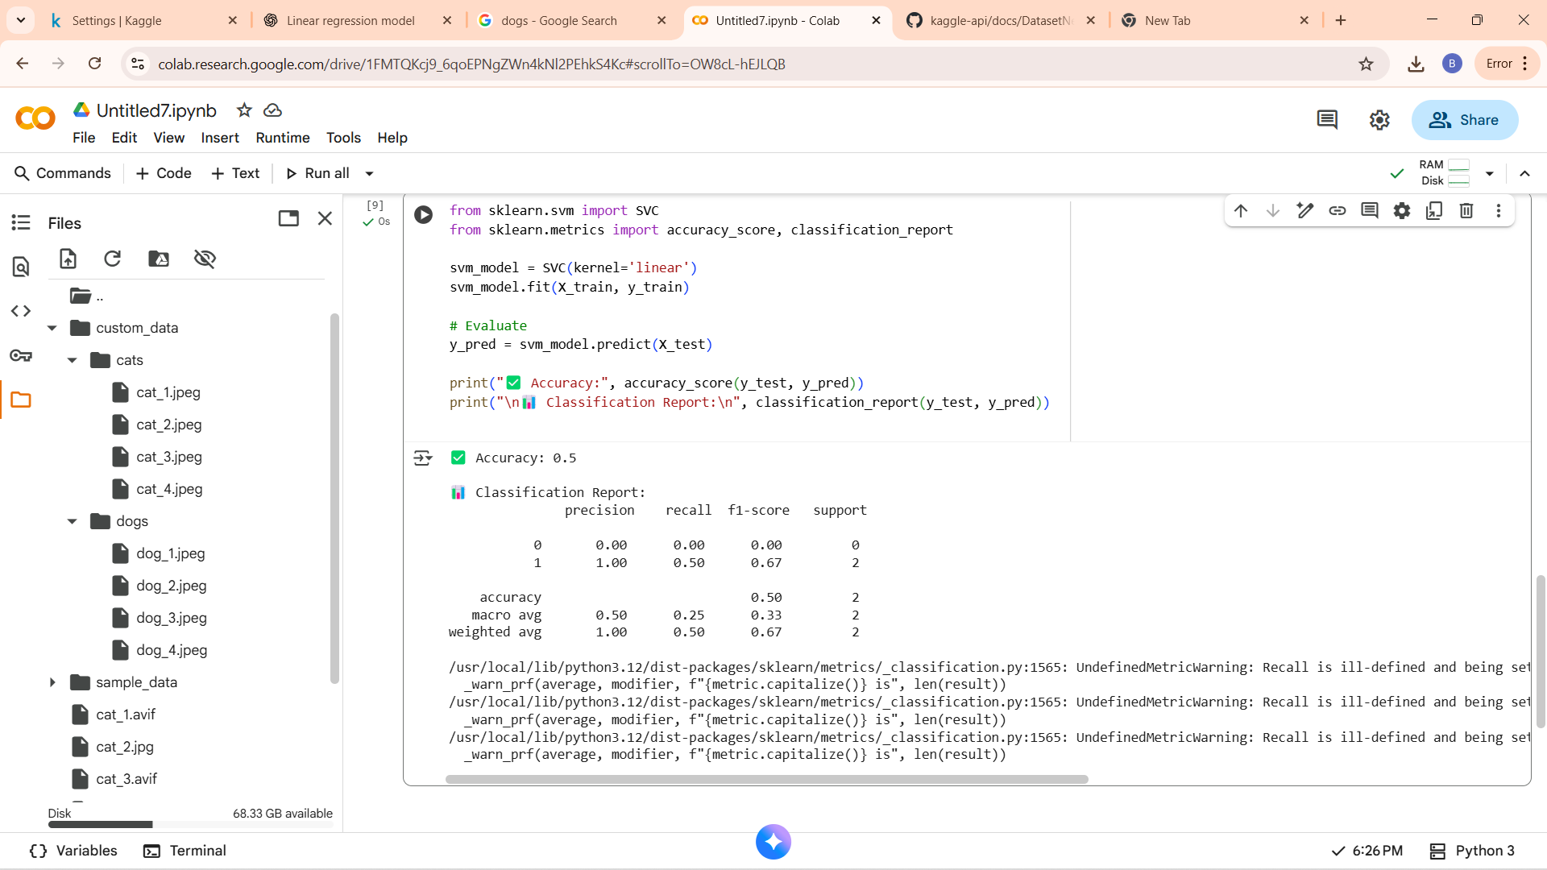

Slide 10
TASK-4
Develop a hand gesture recognition model that can accurately identify and classify different hand gestures from image or video data, enabling intutive human computer interaction and gesture based control system give your own dataset.

Slide 11
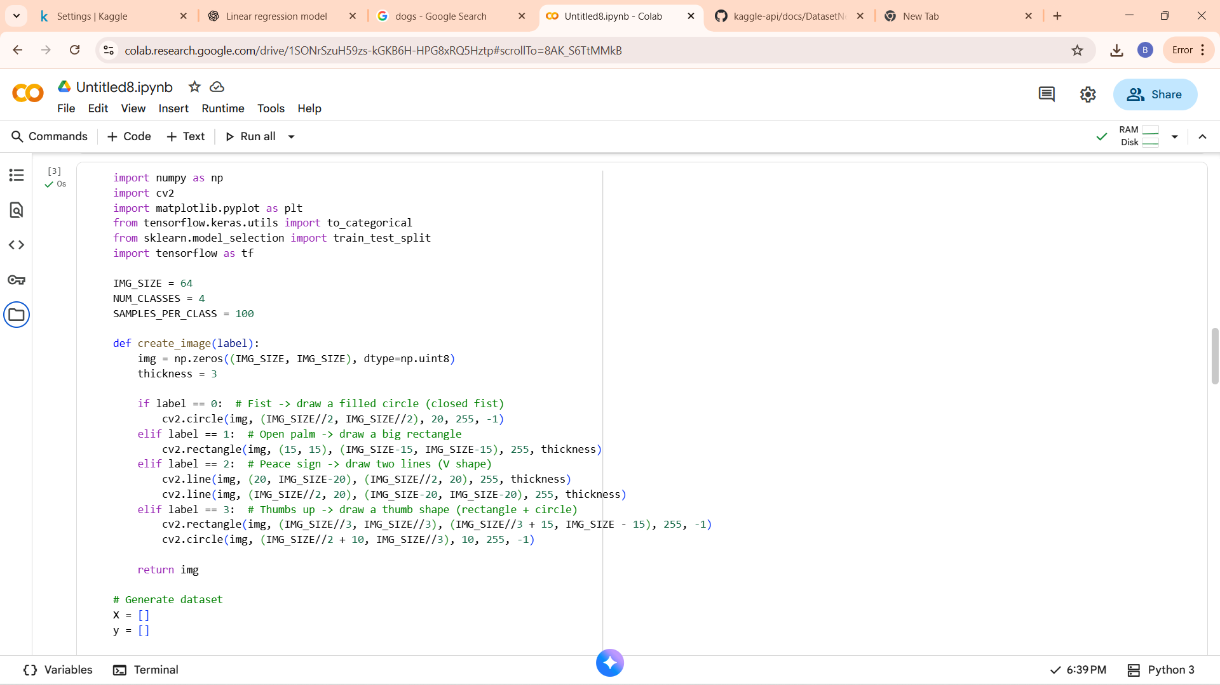
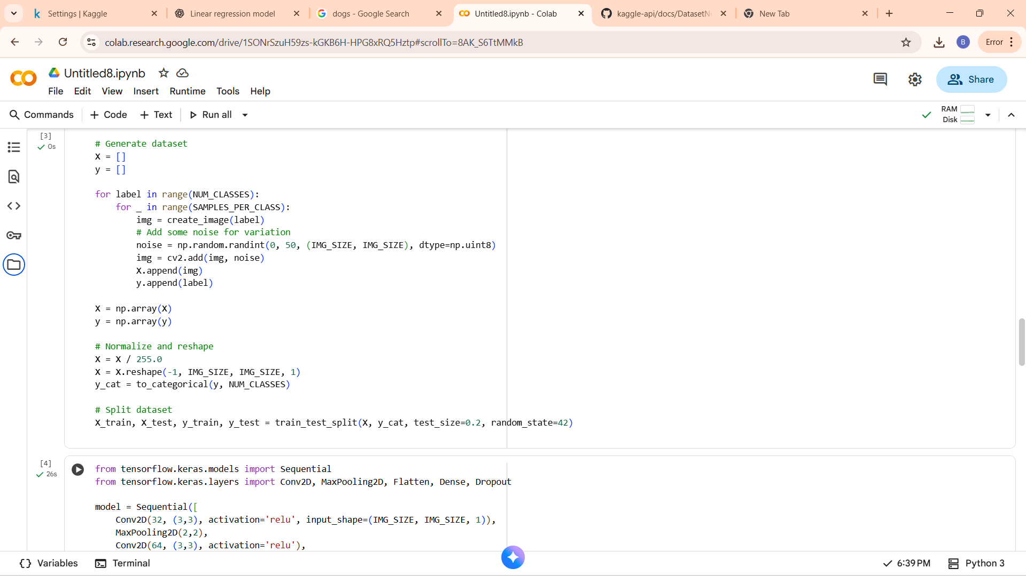
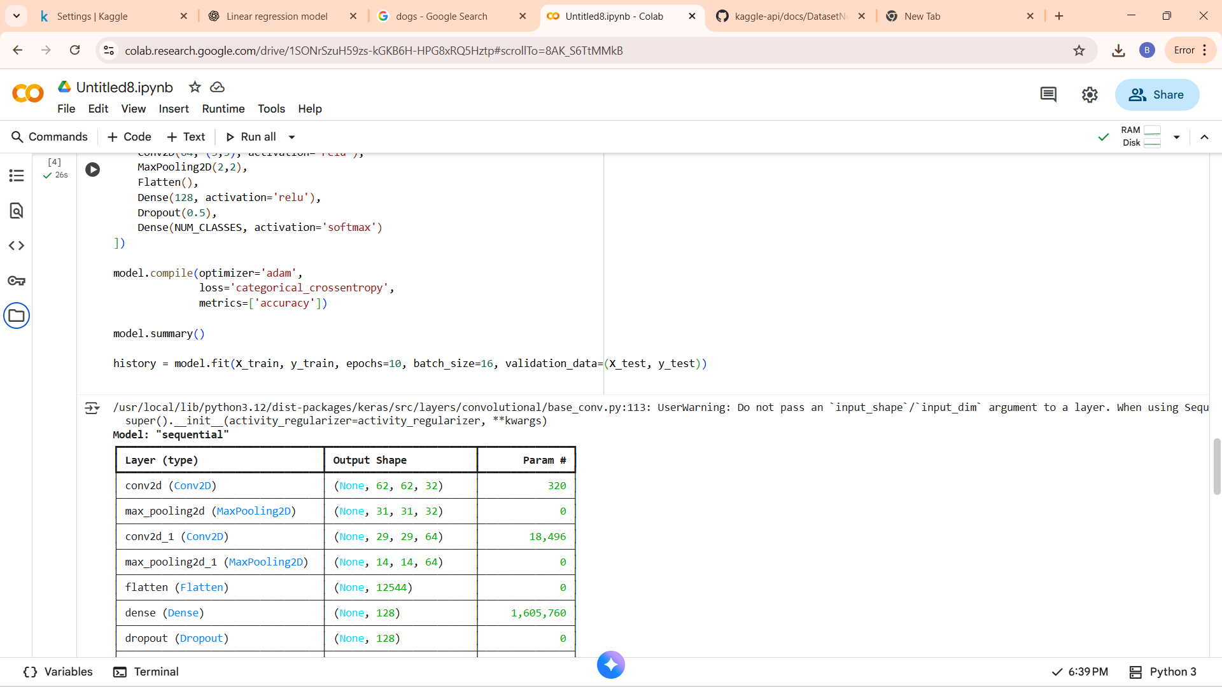
OUTPUT

Slide 12
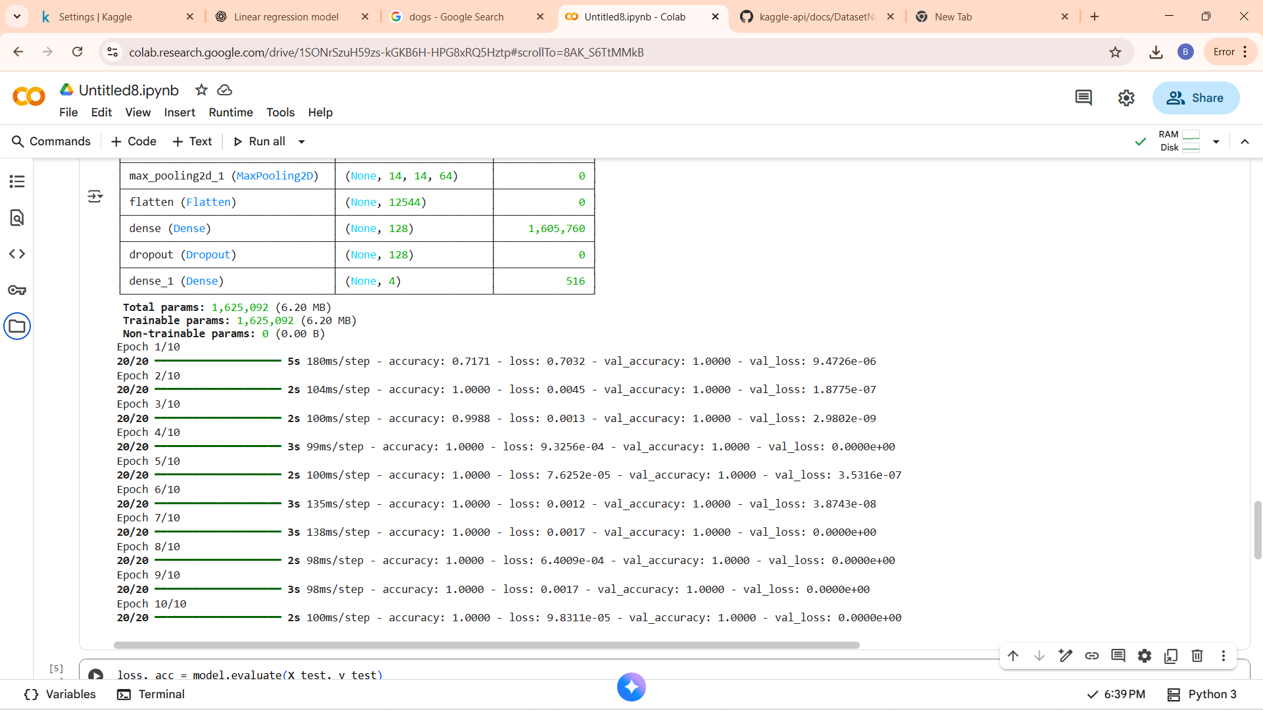
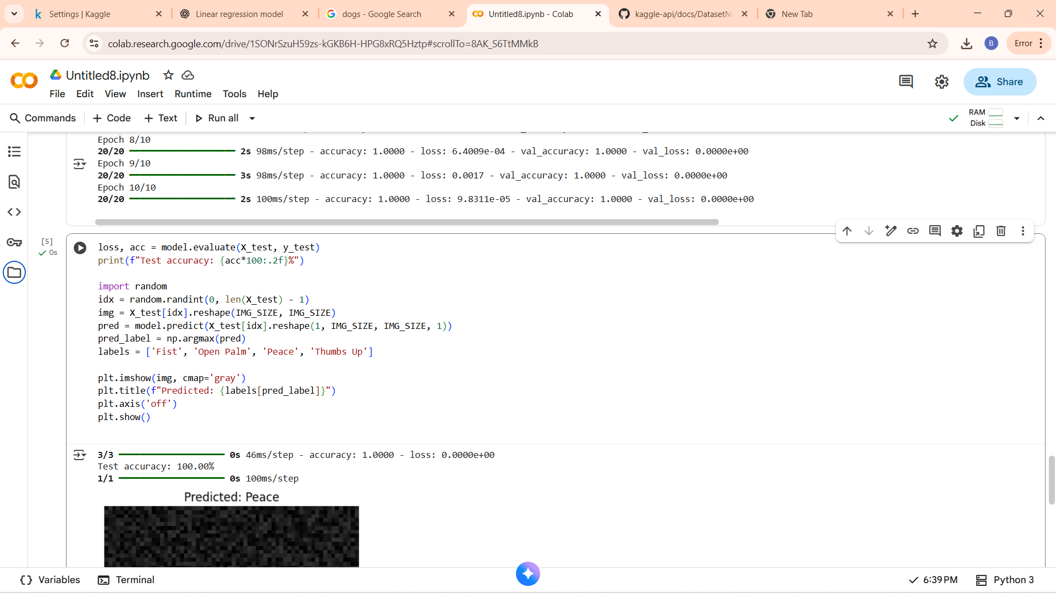
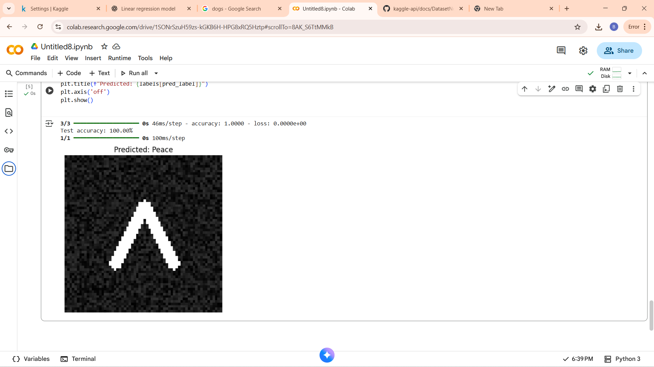

Slide 13
THANKYOU
Submitted By: GOGIKAR YESHIKA NANDA
Internship: Skillcraft Technology
Email:yeshikananda@gmail.com

